Slide 1

Build a bridge using the material given to you. Bridge should be at least 6” long.
The bridge that can hold the most weight is the winner
Activity 1

Slide 2

Soft Skills for Teachers
Bachelors of Education (Hon.) English

Slide 3

Objectives
Define, Identify and apply soft skills in personal and professional settings in order to excel as a professional educator

Slide 4

Course Content
Module components
Introduction to soft skills
2. Communicating effectively with others
3. Working in teams
4. Flexibility and adaptability
5. Problem solving and creativity
6. Managing conflicts
7. Stress management
8. Anger management
9. Managing time
10. Self-motivation

Slide 5
Grading
Formative Assessment = 30%
CA 1 – 30th April
CA 2 – 30th May
Portfolio – last day of Module
Summative Assessments = 70%

Slide 6

Day One - Session 1
What are soft skills?

Slide 7
Origin
The concept of soft skills came to prominence in the 1970s when the U.S. Army began to focus on them
Whitmore (1972, p. II-7) suggested a tentative definition of soft skills: “Soft-skills are (1) important job-related skills (2) which involve little or no interaction with machines

Slide 8
However, even today, half a century later, the terminology of soft skills is still not clear;
Cimatti (2016) documents that the term soft skills is used to indicate all the competences that are not directly connected to a specific task, but they are necessary for any position
Touloumakos (2020) points out that different people mean different things when referring to soft skills. The term soft skills has expanded to encompass a variety of qualities, traits, values, and attributes
Matteson et al. (2016) consider soft skills as a collection of people management skills, important to many professions and job positions

Slide 9
Brown and Luzmore (2023) identified over forty soft skills that were considered important.
1. Communication
2. Collaboration
3. Problem-solving
4. Creativity and innovation
5. Critical thinking
6. Leadership
7. Flexibility/adaptability
8. Social skills
9. Self-regulation/self-awareness
10. Analytical skills
11. Decision-making
12. Integrity
13. Managing learning
14. Conflict management
15. Managing responsibility
16. Positive attitude
17. Well-being/Stress management
18. Identifying work goals/goal orientation
19. Motivation
20. Negotiating
21. Cultural awareness
22. Empathy/understanding others’ needs
23. Planning
24. Conscientiousness
25. Applying work protocols/values
26. Social awareness
27. Influence
28. Initiative
29. Time management
30. Assertiveness
31. Commitment
32. Perseverance
33. Resilience to criticism
34. Competitiveness
35. Curiosity
36. Diplomacy
37. Growth mindset
38. Image distortion
39. Instilling trust
40. Leisure orientation
41. Logical thinking
42. Mobility

Slide 10
The analysis of contemporary academic and non-academic sources, focusing on the most important soft skills for a successful professional and personal life in the twenty-first century, revealed three key findings:
1. Soft skills are an important prerequisite for a sustainable and prosperous working life.
2. There is strong agreement between academics and practitioners (non-academics) about which ten or so soft skills are most important in the twenty-first century.
3. Neither the overall concept of soft skills itself nor individual soft skills have a single, established definition. Similarly, there is no single categorization or hierarchical model of soft skills

Slide 11
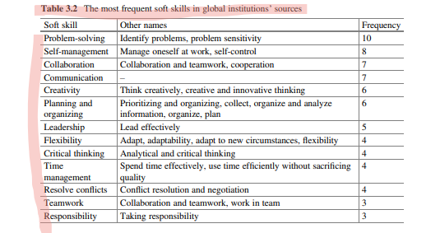
Since 2010, six global institutions, International Labour Organization (ILO), Organisation for Economic Co-operation and Development (OECD), United Nations Children’s Fund (UNICEF), World Bank, World Economic Forum (WEF), and World Trade Organization (WTO), have focused a great deal of attention on the topic of soft skills
REFLECT :
How many of these did you use in Activity 1

Slide 12
Categorization of 21st century skills

Slide 13
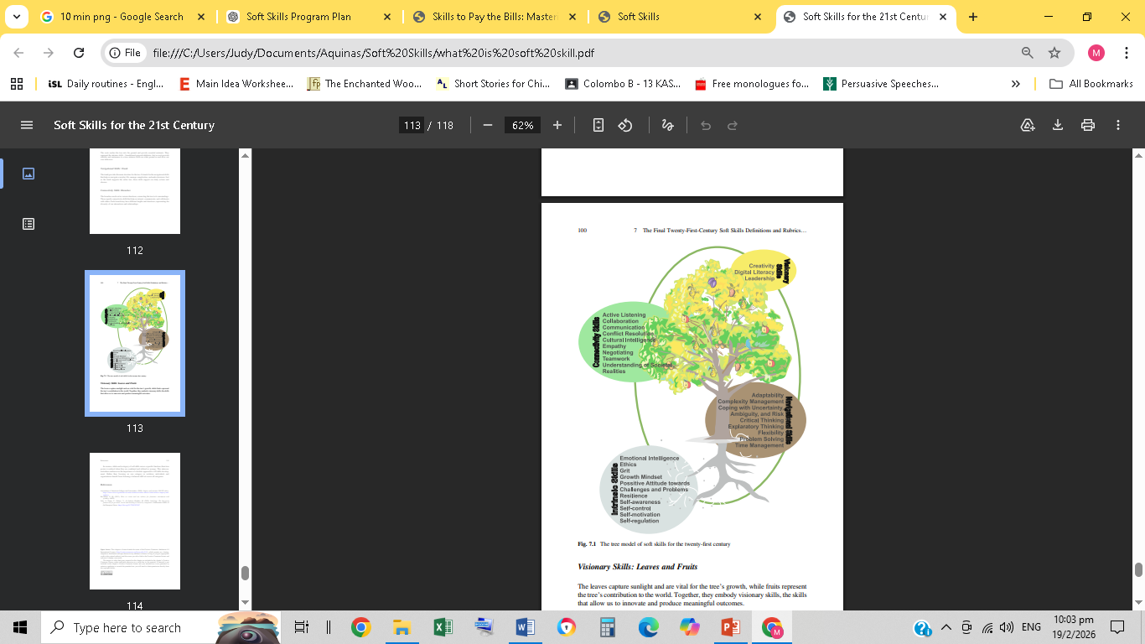
The Tree Model of Soft Skills for the twenty-first century illustrates the interconnectedness and hierarchical nature of the soft skills categories. ( Sala et al. ,2020, p. 21)
Intrinsic Skills: Roots The roots anchor the tree into the ground and provide essential nutrients. They represent the intrinsic skills – foundational personal attributes. Just as roots provide stability and sustenance to a tree, intrinsic skills are what ground us and drive our core behaviors.
Navigational Skills: Trunk The trunk provides the main structure for the tree. It stands for the navigational skills that help us navigate everyday life, manage complexities, and make decisions. Just as the trunk supports the entire tree, these skills support our daily actions and choices.
Connectivity Skills: Branches The branches reach out in various directions, connecting the tree to its surroundings. These signify connectivity skills that help us interact, communicate, and collaborate with others. Each branch may have different lengths and directions, representing the diversity of our interactions and relationships
Visionary Skills: Leaves and Fruits The leaves capture sunlight and are vital for the tree’s growth, while fruits represent the tree’s contribution to the world. Together, they embody visionary skills, the skills that allow us to innovate and produce meaningful outcomes.

Slide 14
Intrinsic Skills
These skills are intrinsic as they originate from within the individual and are crucial for personal and emotional growth. They involve a deep understanding of oneself, managing one’s emotions and behaviors, and a constructive approach to challenging situations. Included here are:
Self-awareness
Self-control
Self-motivation
Self-regulation
Emotional Intelligence
Grit
Growth Mindset
Ethics
Resilience
Positive Attitude Toward Challenges and Problems

Slide 15
Navigational Skills
These skills are unified by their focus on navigating through challenges and uncertainties in various environments. They involve the capacity to analyze and act effectively in situations that are complex, uncertain, or rapidly changing. Included here are:
Adaptability
Flexibility
Complexity Management
Coping with Uncertainty, Ambiguity, and Risk
Critical Thinking
Exploratory Thinking
Problem-Solving
Time Management

Slide 16
Connectivity Skills
The skills in this category are centred around effective interaction with others. They emphasize the importance of understanding and relating to people from diverse backgrounds. Included here are:
Active Listening
Communication
Collaboration
Negotiating
Conflict Resolution
Cultural Intelligence
Empathy
Teamwork
Understanding of Social Realities

Slide 17
Visionary Skills
These skills are future-oriented and involve thinking beyond the current norms. They emphasize the importance of envisioning new possibilities, leveraging technological advancements, and leading others toward innovative directions. Included here are:
Creativity
Digital Literacy
Leadership

Slide 18

Find simple definitions for given skills assigned to your team
Design a quick survey on paper
Carry out the survey and present your findings on what soft skills are considered most important in a teacher by students of Aquinas.
Conclude with your own opinion on the importance of soft skills in teachers with real life examples
Activity 2

Slide 19
Further Reading
Kubátová, J., Müller, M., Kosina, D., Kročil, O., & Slavíčková, P. (2023). Soft skills for the 21st century: Defining a framework for navigating human-centered development in an AI-driven world. Springer.

